Slide 1


David Lord
November 3rd, 2025

Slide 2
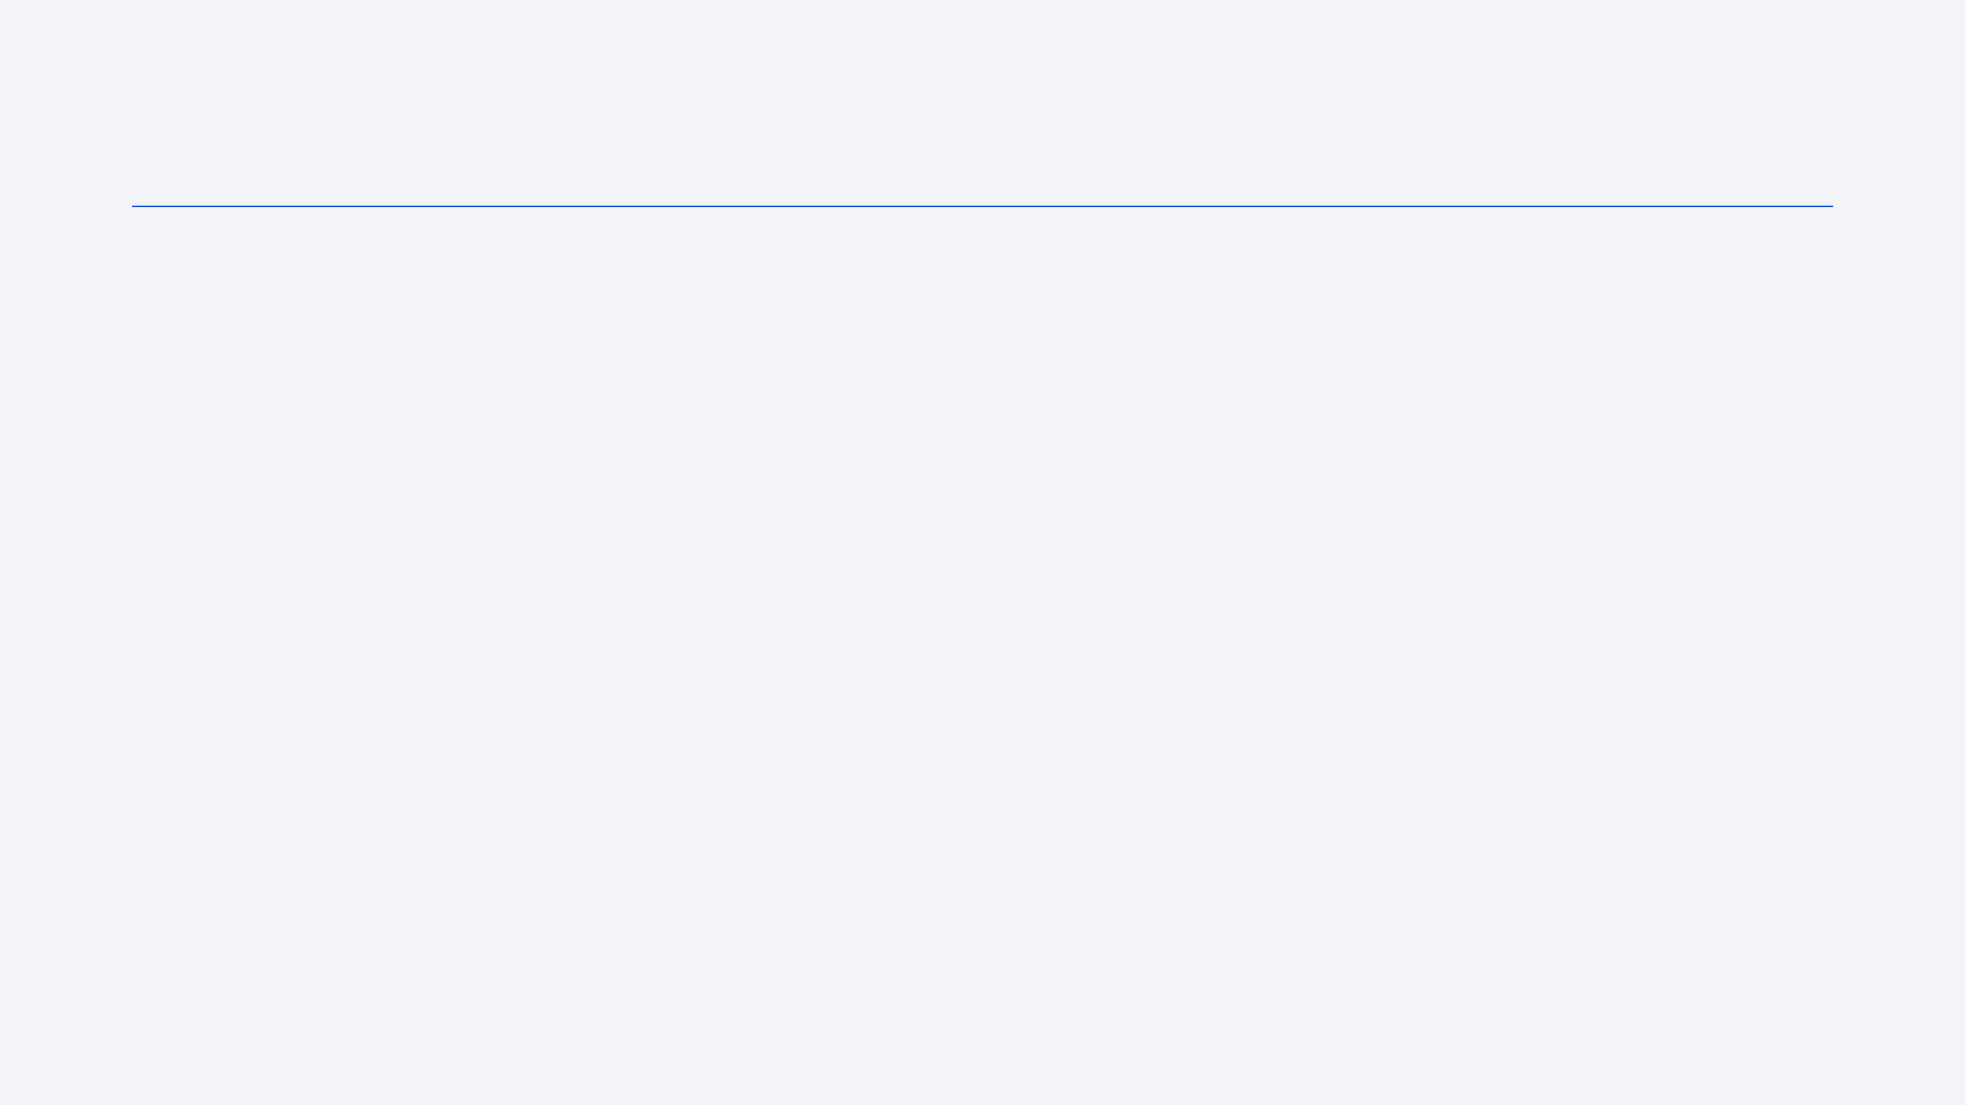
Outline
Executive Summary
Introduction
Methodology
Results
Conclusion
Appendix

Slide 3
Executive Summary
Summary of methodologies
Data Collection (Webscraping and API), Normalize data, build datasheets, perform EDA, build interactive dashboards, build and test models using KNN, Tree, Log, and SVM.
Results Summary
Predictive performance: Best model (SVM) reaches 83% test accuracy with 100% recall for landings and 80% precision (3 false alarms). This is good for catching landings but risky for cost forecasts; 3 FPs could underestimate costs by ≈ $300M (≈$100M/launch delta).
Operational insight: Landing success has trended upward; reuse is now routine. Pair this with evidence that specific boosters (F9 FT/B5 family) succeed at higher payloads—continue prioritizing first-stage reuse as a core cost-savings lever.

Slide 4
Introduction
Competitors: $165 million per launch
SpaceX: $62 million per launch
Potential savings of over $100 million if the first stage rocket is reusable
Utilize publicly available data and machine learning techniques to assess the likelihood of SpaceX reusing the first stage

Slide 5

Section 1

Slide 6
Methodology
Executive Summary
Data collection methodology:
Data was webscraped from Wikipedia and SpaceX APIs.
Perform data wrangling
Data was formatted, and rows with missing data were removed.
Perform exploratory data analysis (EDA) using visualization and SQL
Perform interactive visual analytics using Folium and Plotly Dash
Perform predictive analysis using classification models
Use GridSearchCV and KNN, Tree, SVM, and Log models

Slide 7
Data Collection
Describe how data sets were collected.
You need to present your data collection process use key phrases and flowcharts

Slide 8
Data Collection – SpaceX API
API GET
Normalize JSON response
Enrich via IDs
Clean & Filter Falcon 9 Launch
Export CSV (dataset_part_1.csv)
Request -> response -> normalize -> parse-> data set
https://github.com/Lordd007/spacey/blob/main/jupyter-labs-spacex-data-collection-api-v2.ipynb

Slide 9
Data Collection – Scraping
HTTP GET Launch from June 2021
HTTP Response
BeautifulSoup
Parse
Export CSV (spacex_web_scraped.csv)
Request -> response -> BeautifulSoup -> parse-> data set
https://github.com/Lordd007/spacey/blob/main/jupyter-labs-webscraping.ipynb
Notes:
Static url = (https://en.wikipedia.org/w/index.php? title=List_of_Falcon_9_ and_Falcon_Heavy_launches &oldid=1027686922

Slide 10
Data Wrangling
Load Dataset
Remove missing values
Identify Structure
Modify Dataset
Export CSV (dataset_part_2.csv)
Loaded dataset_part_1.csv
Removed missing values
Identified the structure
Modified the dataset by splitting the Outcome of launch into types and created Class binary where ‘1’ is a Success, and ‘0’ is a failure.
Export the dataset as dataset_part_2.csv https://github.com/Lordd007/spacey/blob/main/labs-jupyter-spacex-Data%20wrangling-v2.ipynb

Slide 11
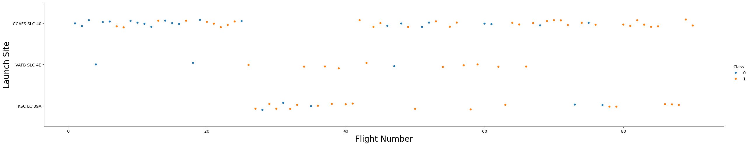
EDA with Data Visualization
CCAFS: 40% -> 75% success launch rate
VAFB: 72% -> 86% success launch rate
KSC: 75% -> 83% success launch rate
https://github.com/Lordd007/spacey/blob/main/jupyter-labs-eda-dataviz-v2.ipynb

Slide 12
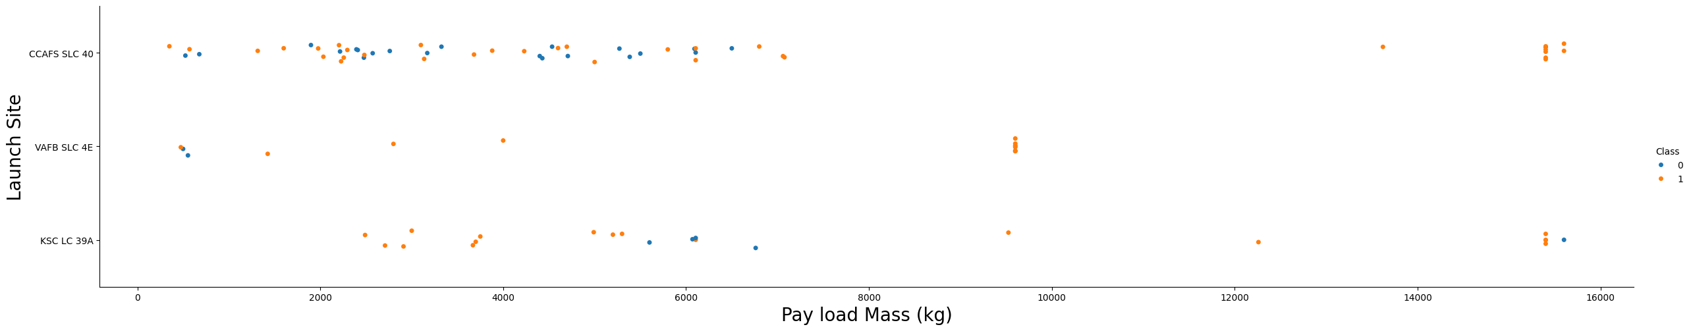
EDA with Data Visualization
CCAFS: >7000 kg 100 %success rate
VAFB: 1500->10000 kg 100 %success rate
KSC: No consistent payload success rate

Slide 13
EDA with SQL
From 2010-06-04 to 2017-03-20
Queried conditions to result in a successful outcomes.
F9 B5 B1* Boosters best for maximum payload and successful outcome.
https://github.com/Lordd007/spacey/blob/main/jupyter-labs-eda-sql-coursera_sqllite.ipynb
Landing Outcome | Total
No attempt | 10
Success (drone ship) | 5
Failure (drone ship) | 5
Success (ground pad) | 3
Controlled (ocean) | 3
Uncontrolled (ocean) | 2
Failure (parachute) | 2
Precluded (drone ship) | 1

Slide 14
Build an Interactive Map with Folium
Markers: Represent Launch Site
Circle: Size represents the number of launches
Zoom: Zoom in on a location to see the number of success/failures
https://nbviewer.org/github/Lordd007/spacey/blob/main/lab-jupyter-launch-site-location-v2.ipynb

Slide 15
Build a Dashboard with Plotly Dash
Added a dropdown menu to filter between a single site and all sites.
Added a pie chart to visualize success rate of all sites
Added a Payload filter to see the success rate. https://github.com/Lordd007/spacey/blob/main/spacex_dash_app.py

Slide 16
Predictive Analysis (Classification)
Split Train and Test data
Hyperparameters
Tune Parameters via GridSearch
Test Model based on best parameters
Score the model based on accuracy
Select Model
Train/test split (stratified).
Select model(Logistic Regression, Decision Tree, SVM, and KNN) and created numeric features (for SVM/KNN) and encoded categoricals
Selected Hyperparameters to tune model
Trained Logistic Regression, Decision Tree, SVM, and KNN with GridSearchCV (k-fold).
Fit model based on best parameters
Scored primarily by accuracy
https://github.com/Lordd007/spacey/blob/main/SpaceX-Machine-Learning-Prediction-Part-5-v1.ipynb

Slide 17
Results
Exploratory data analysis results
Interactive analytics demo in screenshots
Predictive analysis results

Slide 18

Section 2

Slide 19
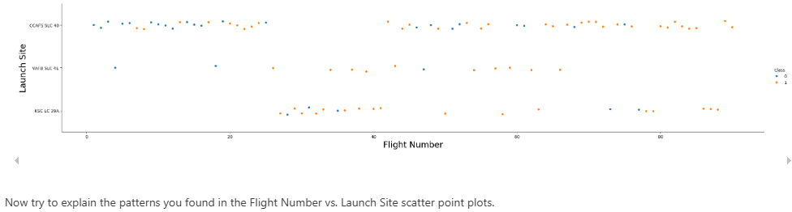
Flight Number vs. Launch Site

Slide 20
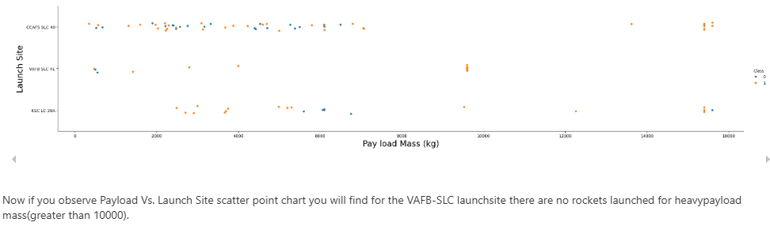
Payload vs. Launch Site

Slide 21
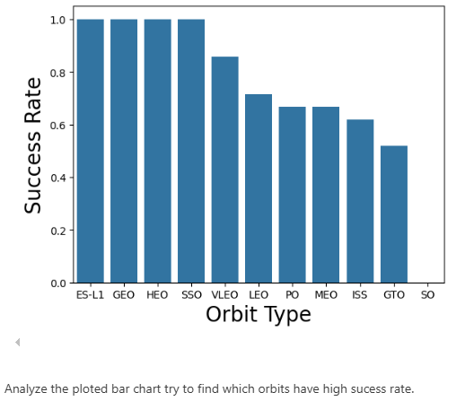
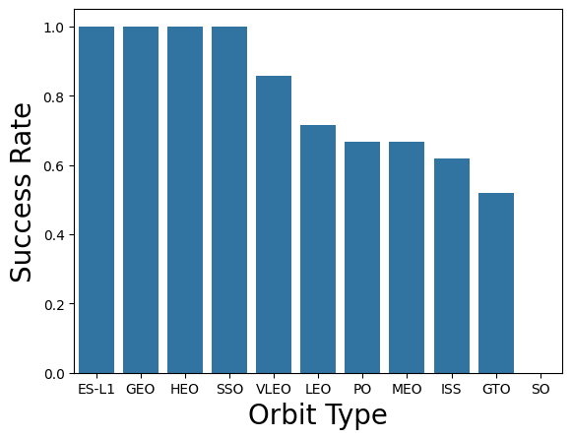
Success Rate vs. Orbit Type

Slide 22
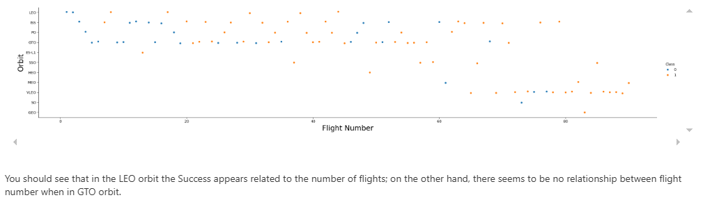
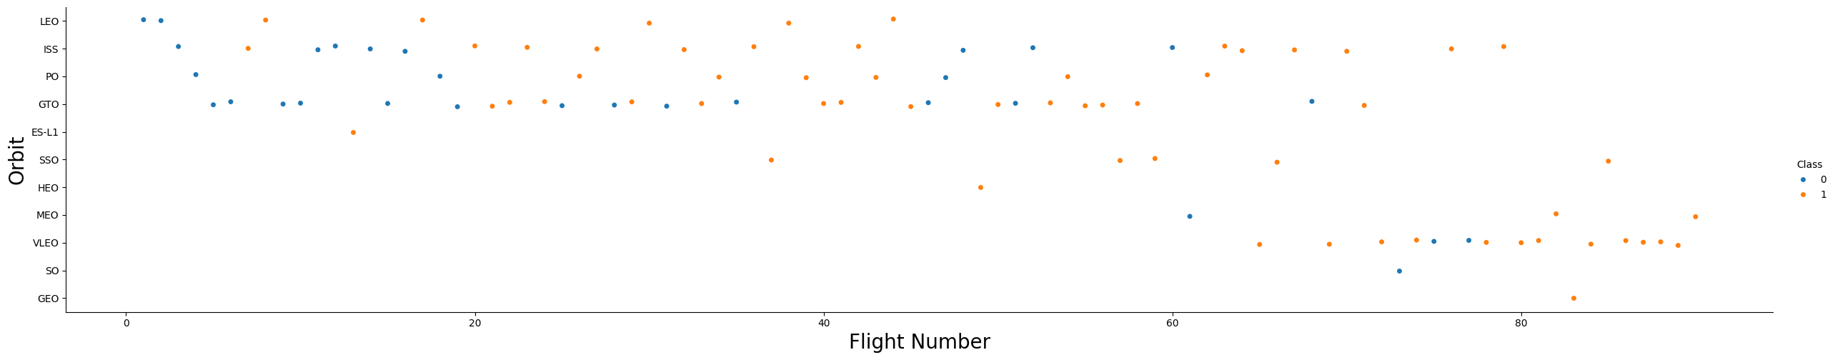
Flight Number vs. Orbit Type

Slide 23
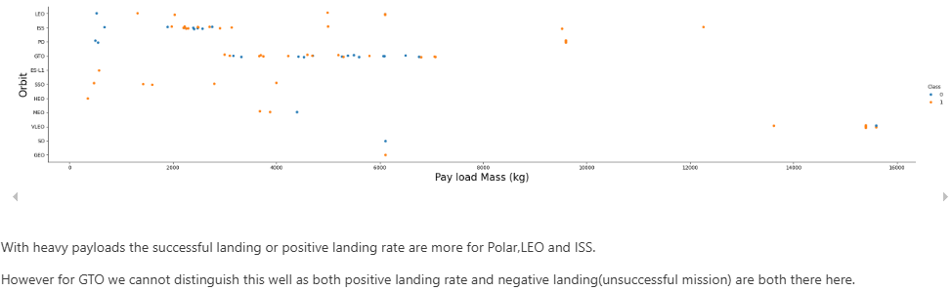
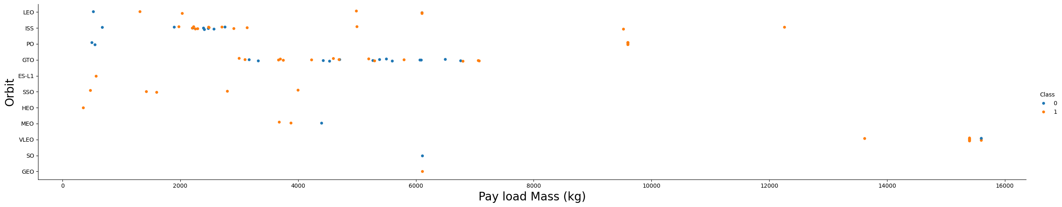
Payload vs. Orbit Type

Slide 24
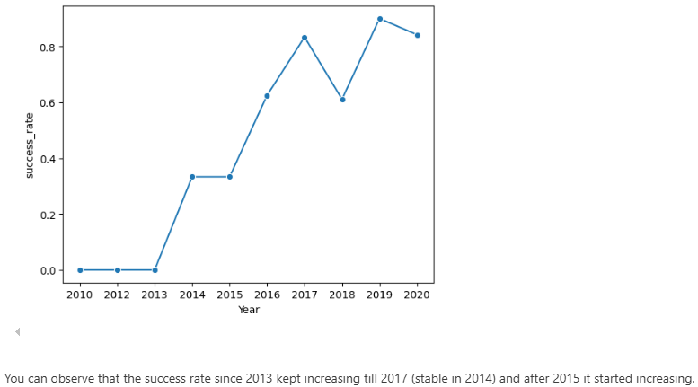
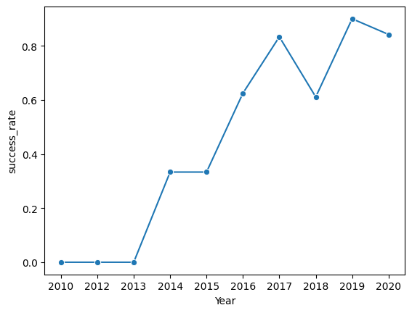
Launch Success Yearly Trend

Slide 25
All Launch Site Names
Names of the unique launch sites: CCAFS LC-40, CCAFS SLC-40,KSC LC-39A, and VAFB SLC-4E
These were the only launch sites examined in this dataset.

Slide 26
Launch Site Names Begin with 'CCA'
Date | Time (UTC) | Booster_Version | Launch_Site | Payload | PAYLOAD_MASS__KG_ | Orbit | Customer | Mission_Outcome | Landing_Outcome
2010-06-04 | 18:45:00 | F9 v1.0 B0003 | CCAFS LC-40 | Dragon Spacecraft Qualification Unit | 0 | LEO | SpaceX | Success | Failure (parachute)
2010-12-08 | 15:43:00 | F9 v1.0 B0004 | CCAFS LC-40 | Dragon demo flight C1, two CubeSats, barrel of Brouere cheese | 0 | LEO (ISS) | NASA (COTS) NRO | Success | Failure (parachute)
2012-05-22 | 7:44:00 | F9 v1.0 B0005 | CCAFS LC-40 | Dragon demo flight C2 | 525 | LEO (ISS) | NASA (COTS) | Success | No attempt
2012-10-08 | 0:35:00 | F9 v1.0 B0006 | CCAFS LC-40 | SpaceX CRS-1 | 500 | LEO (ISS) | NASA (CRS) | Success | No attempt
2013-03-01 | 15:10:00 | F9 v1.0 B0007 | CCAFS LC-40 | SpaceX CRS-2 | 677 | LEO (ISS) | NASA (CRS) | Success | No attempt

Slide 27
Total Payload Mass
Total payload carried by boosters from NASA: 45596 kg

Slide 28
Average Payload Mass by F9 v1.1
Average payload mass carried by booster version F9 v1.1: 2,534 kg

Slide 29
First Successful Ground Landing Date
Date: 2015-12-22
Although launches started in 2010, the first successful Ground landing did not occur until December 2015.

Slide 30
Successful Drone Ship Landing with Payload between 4000 and 6000
The F9 FT B1* Boosters were successful on drop ship landing with payloads between 4000 to 6000 kg
Booster Version
F9 FT B1021.2
F9 FT B1031.2
F9 FT B1022
F9 FT B1026

Slide 31
Total Number of Successful and Failure Mission Outcomes
Approximately a 1% failure rate across all launch sites.
Outcome | Total
Success | 100
Failure | 1

Slide 32
Boosters Carried Maximum Payload
F9 B5 B1* Boosters best for maximum payload and successful outcome.
Booster Version
F9 B5 B1048.4
F9 B5 B1049.4
F9 B5 B1051.3
F9 B5 B1056.4
F9 B5 B1048.5
F9 B5 B1051.4
F9 B5 B1049.5
F9 B5 B1060.2
F9 B5 B1058.3
F9 B5 B1051.6
F9 B5 B1060.3
F9 B5 B1049.7

Slide 33
2015 Launch Records
Two failed landings at drone ships occurred in 2015 in January and April. They launched from CAFS LC-40.
month_name | Booster_Version | Launch_Site | Landing_Outcome
January | F9 v1.1 B1012 | CCAFS LC-40 | Failure (drone ship)
April | F9 v1.1 B1015 | CCAFS LC-40 | Failure (drone ship)

Slide 34
Rank Landing Outcomes Between 2010-06-04 and 2017-03-20
Early attempts resulted in a lot of failures, but there were still some successes with the drone ship and ground pad.
Landing Outcome | Total
No attempt | 10
Success (drone ship) | 5
Failure (drone ship) | 5
Success (ground pad) | 3
Controlled (ocean) | 3
Uncontrolled (ocean) | 2
Failure (parachute) | 2
Precluded (drone ship) | 1

Slide 35

Section 3

Slide 36
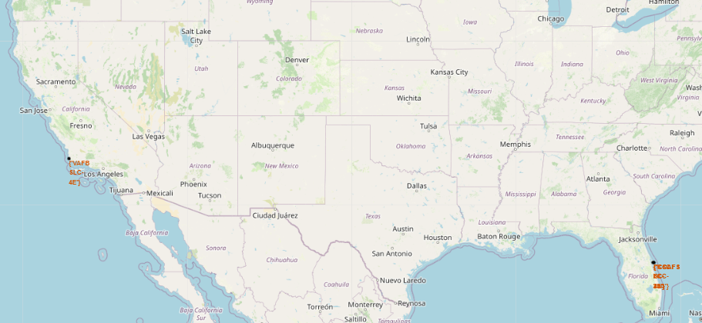
Launch site data mapped
Longitude and latitude data mapped to visualize the launch sites.

Slide 37
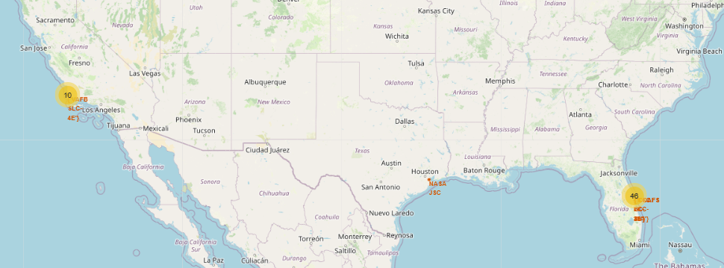
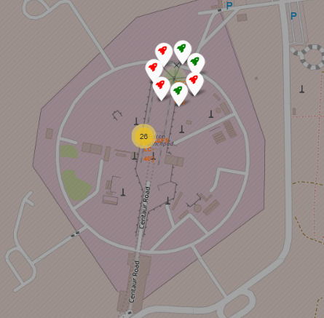
Launch Sites Cluster Maps
All launch sites are close to the coastline.
It helps with drone ship recovery of first stage rockets.
Majority of the flights take off from Florida, which is close to NASA.

Slide 38
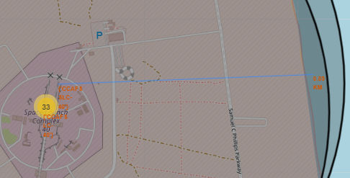
SLC 40 Coastline Proximity
Distance from SLC to nearest coastline: .89 km
Based on its proximity, it makes it easier for drone ships to recapture first stage rockets and reduce the risk to human populations in the land area.

Slide 39

Section 4

Slide 40
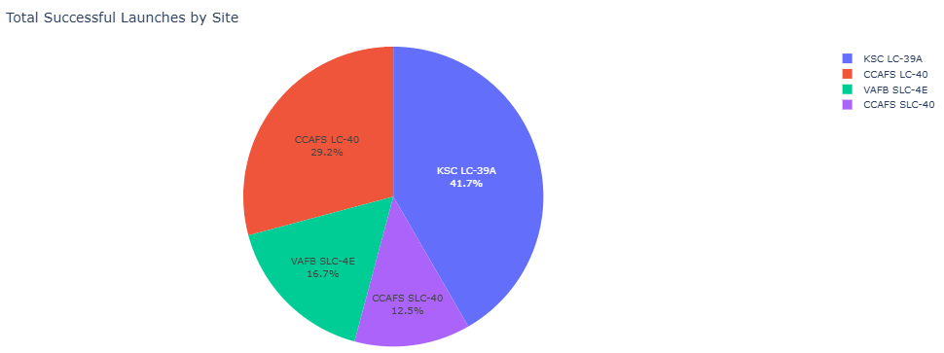
SpaceX Launch Records Dashboard – Success Rate
KSC makes up the largest percent of successful launches, and SLC-40 makes up the lower percent.

Slide 41
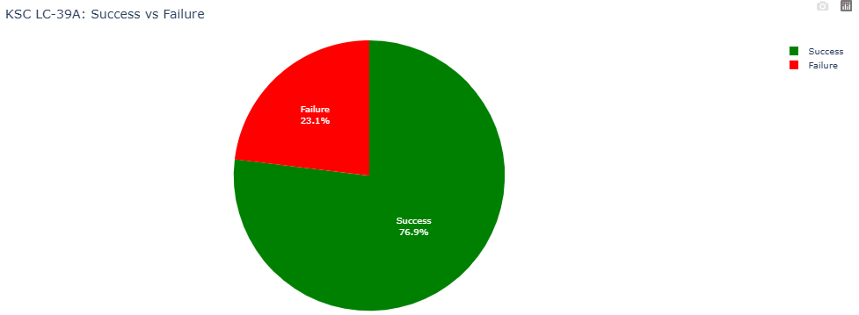
SpaceX Launch Records Dashboard – Success Rate
Although it has the highest success rate, it has not improved as much as the other sites.

Slide 42
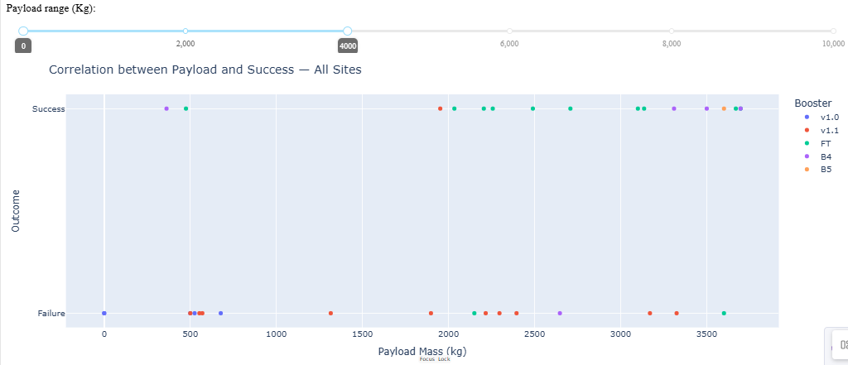
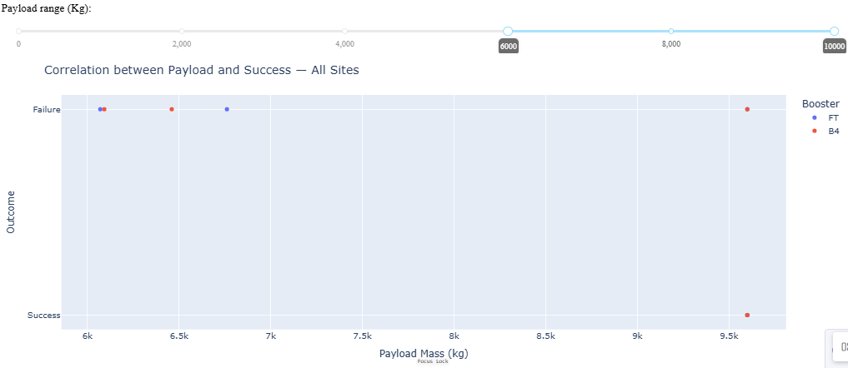
SpaceX Launch Records Dashboard – Payload and Site
With the smaller payloads, there were a greater variety of booster available.
As the payload increased, the booster versions decreased to just 2: FT and B4.

Slide 43

Section 5

Slide 44
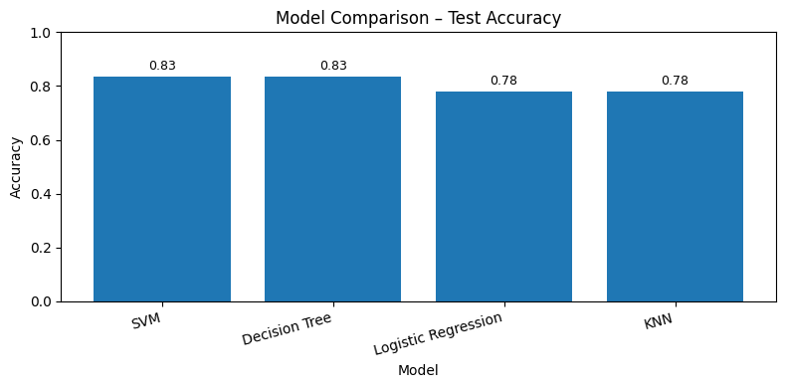
Classification Accuracy
Best Model: SVM
Best Accuracy: 83%

Slide 45

Confusion Matrix
The model catches all actual landings but makes 3 false alarms.
This could result in an underestimate of costs ~ 300 million dollars since it would expect 3 more rockets to reuse.

Slide 46
Conclusions
Predictive performance: Best model (SVM) reaches 83% test accuracy with 100% recall for landings and 80% precision (3 false alarms). This is good for catching landings but risky for cost forecasts; 3 FPs could underestimate costs by ≈ $300M (≈$100M/launch delta).
Operational insight: Landing success has trended upward; reuse is now routine. Pair this with evidence that specific boosters (F9 FT/B5 family) succeed at higher payloads—continue prioritizing first-stage reuse as a core cost-savings lever.
Next steps: Tune for higher precision (threshold calibration, class-weighted or cost-sensitive training), add features (payload mass, orbit, booster version, site, weather/sea state), extend the dataset, and calibrate probabilities; monitor with PR curves to reduce costly false positives.

Slide 47
Appendix
Include any relevant assets like Python code snippets, SQL queries, charts, Notebook outputs, or data sets that you may have created during this project

Slide 48


